Slide 1


K.RAMAKRISHNAN COLLEGE OF TECHNOLOGY
(AUTONOMOUS), TRICHY.
DEPARTMENT OF
COMPUTER SCIENCE AND ENGINEERING
20CS5501 DESIGN PROJECT-1
Batch No : 20
Date : 06.12.2024

Slide 2
DIY PROJECT PLANNER WITH AI
Guided by Team
Mrs. R.SATHYA M.E.,(PhD) Raghul P (811722104116)
Assistant Professor, CSE Riyaz Ahmed H (811722104124)
Sachin B (811722104126)
Raseen Raja R (811722104305)

Slide 3
OBJECTIVE OF THE PROJECT
Develop an AI-powered tool to assist users in planning and managing DIY projects.
Provide intelligent task recommendations based on user input and historical data.
Optimize task scheduling and resource allocation for efficient project execution.
Offer real-time progress tracking and dynamic updates to project timelines.
Incorporate cost estimation and resource management to ensure budget control.
Enhance user experience through personalized project suggestions and reminders.
Facilitate seamless project monitoring with AI-driven insights and reporting.

Slide 4
ABSTRACT
The DIY Project Planner with AI simplifies project management by integrating AI to suggest tasks, estimate resources, and track progress.
Users benefit from optimized scheduling, personalized reminders, and dynamic project insights.
The AI model learns from user behavior and historical data, ensuring accurate, actionable recommendations.

Slide 5
LITERATURE SURVEY
TITLE OF THE PAPER | AUTHOR (S) | PUBLISHER | PAPER GIST | TECHNOLOGY USED
John | AI in Task Planning | 2021 | Proposed task recommendations using ML algorithms. | Machine Learning
Smith | Resource Allocation Models | 2020 | Focused on resource optimization for project planners. | Optimization
Lee | Cost Estimation Tools | 2019 | Integrated AI to improve cost estimation accuracy. | AI Techniques
Brown | Interactive Project Planning | 2022 | Developed a chatbot for project planning assistance. | Natural Language Processing
Davis | Dynamic Scheduling Systems | 2023 | Used DL models to automate project schedule adjustments. | Deep Learning

Slide 6
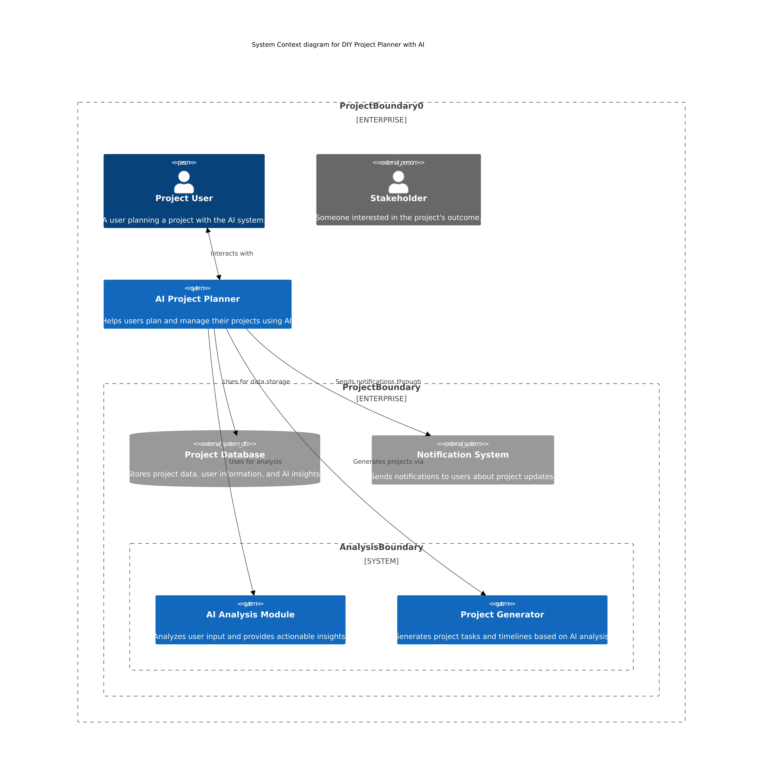
PROPOSED SYSTEM ARCHITECTURE

Slide 7
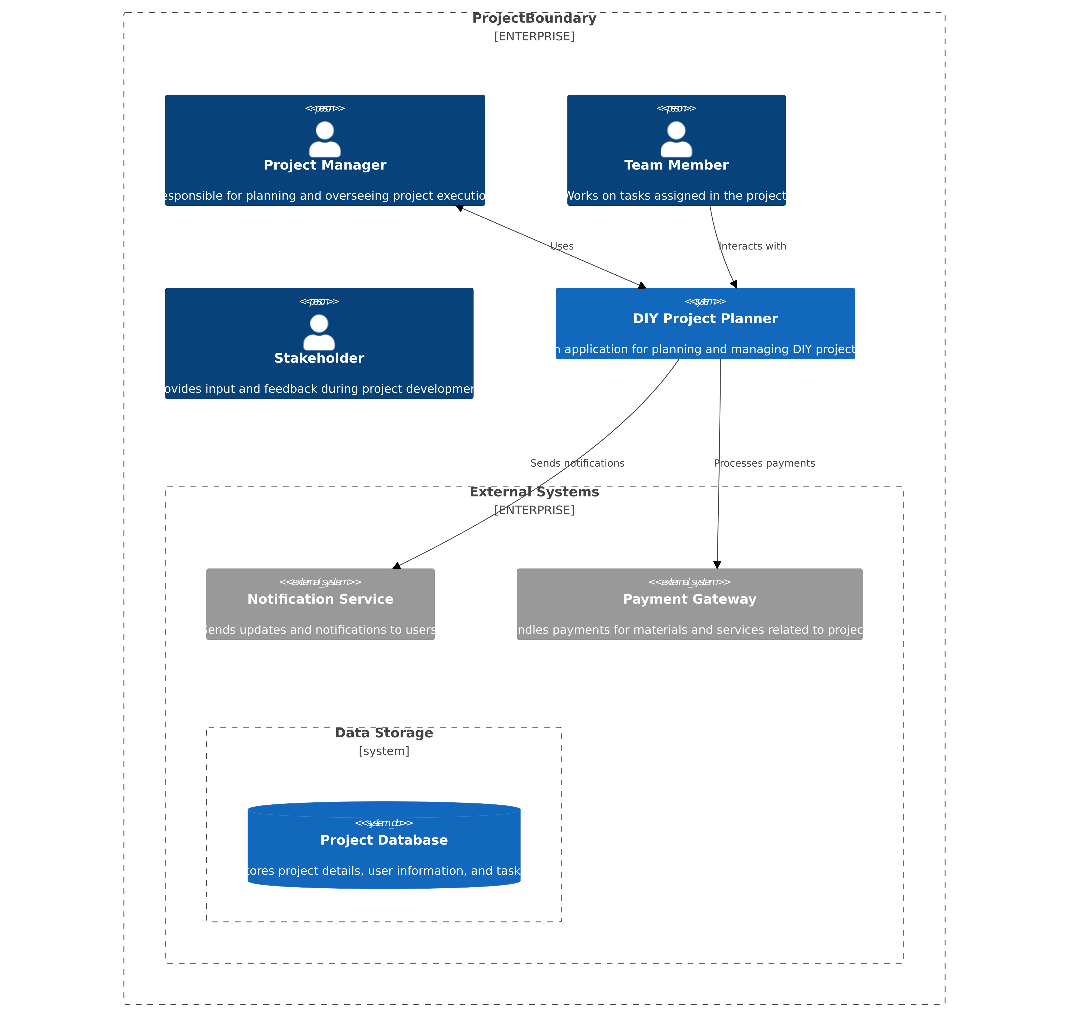
EXISTING SYSTEM ARCHITECTURE

Slide 8
SOFTWARE AND HARDWARE REQUIREMENTS
HARDWARE
SOFTWARE
Operating System | : Cross-platform (Windows,macos)
Python Version | : Python 3x
Web framework | : Django
Front-end | : HTML,CSS,JAVA SCRIPT
Version-control | : GIT AND GITHUB
Database | : POSTGRESQL
API Tool | : POSTMAN
Processor | : Dual core processor 2.6.0 GHZ
RAM | : 4GB
Hard Disk | : Min 4GB
Compact Disk | : 650 MB
Keyboard | : Standard Keyboard

Slide 9
MODULES
User Registration and Authentication
Admin Panel
AI Task Suggestion Module
Resource Management and Cost Estimation
Summary

Slide 10
SUMMARY OF MODULE-1
User Registration and Authentication
Functionality: Handles user accounts, sign-ups, logins, and secure authentication using JWT.
Benefit: Allows users to save projects and access personalized suggestions.

Slide 11
SUMMARY OF MODULE-2
Admin Panel
Functionality: It used to add, delete,and update the projects .
Benefit: Helps user to get latest DIY project with updated steps.

Slide 12
SUMMARY OF MODULE-3
AI Task Suggestion Module
Functionality: Recommends project tasks based on the user’s project type and past data.
Benefit: Saves time by offering relevant suggestions and predicting potential challenges.

Slide 13
SUMMARY OF MODULE-4
Resource Management and Cost Estimation
Functionality: Estimates the cost of required materials and resources for the project.
Benefit: Helps users stay within their budget and plan for necessary materials.

Slide 14
SUMMARY OF MODULE-5
Summary
The system ensures secure user access through a streamlined registration and authentication process. The admin panel enables efficient management of users, tasks, and resources. AI-driven task recommendations and resource optimization enhance project planning while providing accurate cost estimations.

Slide 15
RESULTS AND DISCUSSION
Successfully developed a DIY Project Planner with AI, providing task suggestions, resource management, and cost estimation tailored to users' project requirements.
Enhanced user experience with intuitive interfaces for both admin and user functionalities, ensuring seamless project management.
The AI-powered task suggestion module proved effective in improving the accuracy of task recommendations, considering past project data and user preferences.
Resource management and cost estimation modules demonstrated practical utility in budget planning and allocation.
User feedback highlighted the need for more customization options and integration of additional project categories.

Slide 16
CONCLUSION
Streamlined Project Planning: Project planning is simplified using the system as it automates suggestions to add tasks and manage resources by using AI.
User-Friendly Interface: The admin and user modules are designed to be user-friendly, intuitive, and easy to navigate.
Enhanced Productivity: With the inclusion of AI modules, users can focus on execution rather than spending time on manual planning tasks.
Scope for Future Enhancements: While the system performs effectively, additional features like advanced customization and broader project categories could further improve its functionality and adaptability.

Slide 17
THANK YOU

